Slide 1
VARIANCE BIAS TRADEOFF

Slide 2
What is Bias?
Bias refers to the error introduced by approximating a real-world problem with a simplified model. In predictive modeling, bias measures how far off the predictions are from the true values. A model with high bias tends to oversimplify the data and may consistently miss relevant patterns.
What is variance?
Refers to the variability of model predictions across different training datasets. It measures how much the model's predictions fluctuate when trained on different subsets of the training data.
Why is variance a problem?
Variance indicates that your model is not reliable. Suppose minor changes in the input data result in significant changes in the output. In that case, the model has not properly extracted the underlying patterns, and its decision making cannot be trusted.

Slide 3
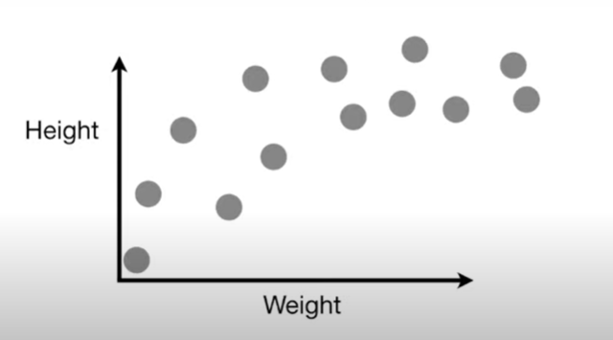
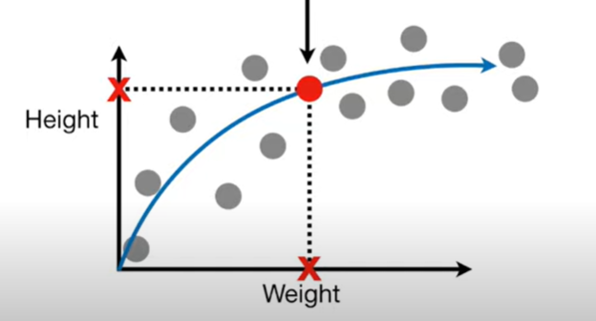
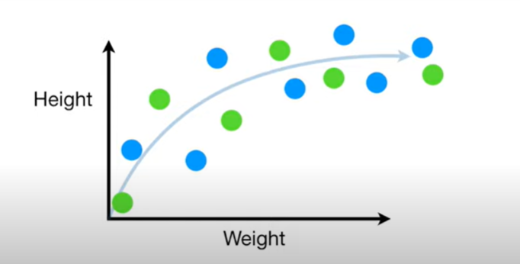
Imagine we want to find a height of someone depending on the weight!
Training set
Testing set

Slide 4
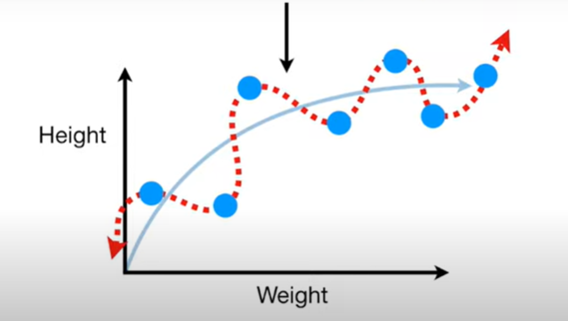
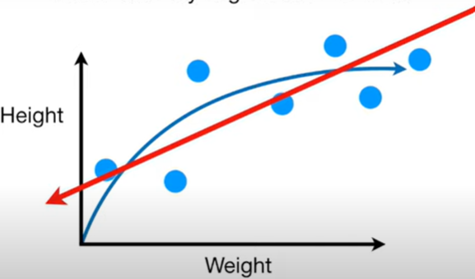
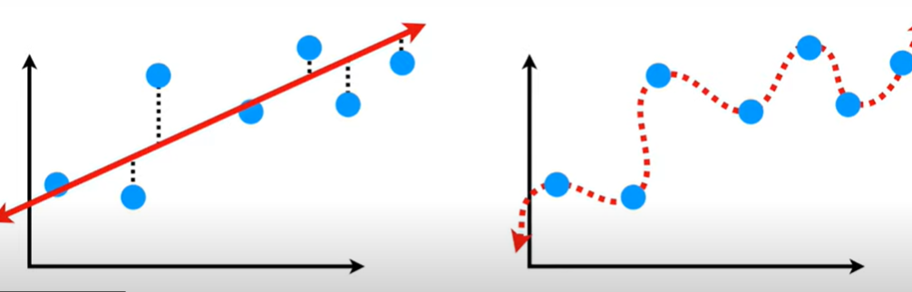
TRAINING SET
Squiggly line
Linear Regression aka Least Squares
High Bias
Low Bias
Sum of squares

Slide 5
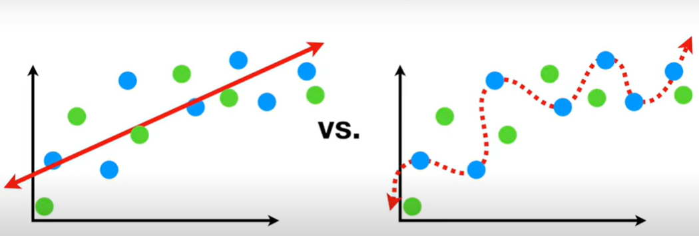
TESTING SET

Slide 6
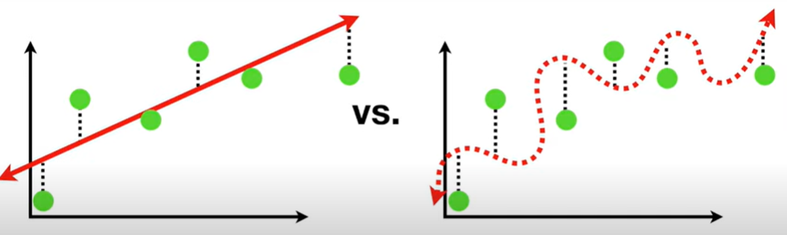
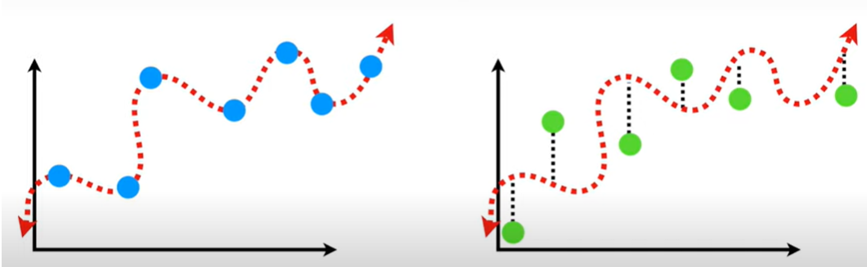
The straight line did a better job when we did a sum of squares
The difference in fits between data sets is called VARIANCE

Slide 7
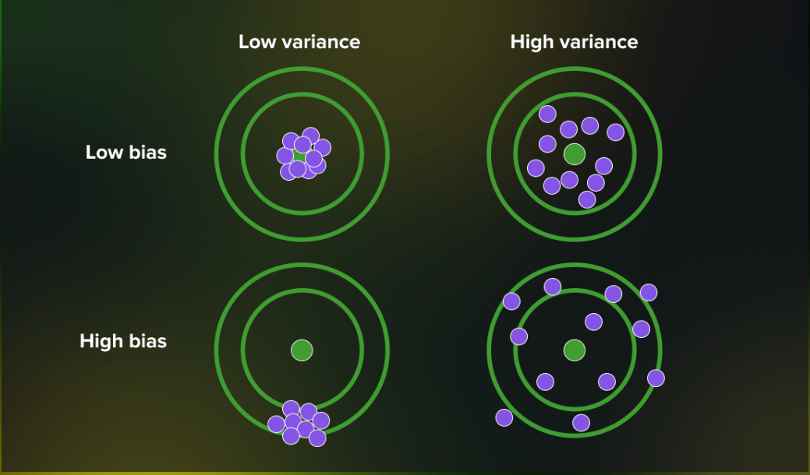
scenarios
Low bias, low variance: ideal model
Not always the case in Machine learning models
Low bias, high variance: results in overfitting
It occurs when a model has too many parameters and fits too closely to the training data.
High bias, low variance: results in underfitting
This happens when the model doesn’t learn well from the training data or has too few parameters, leading to underfitting issues.
High bias, high variance: results in inaccurate predictions
The predictions are both inconsistent and inaccurate on average.

Slide 8
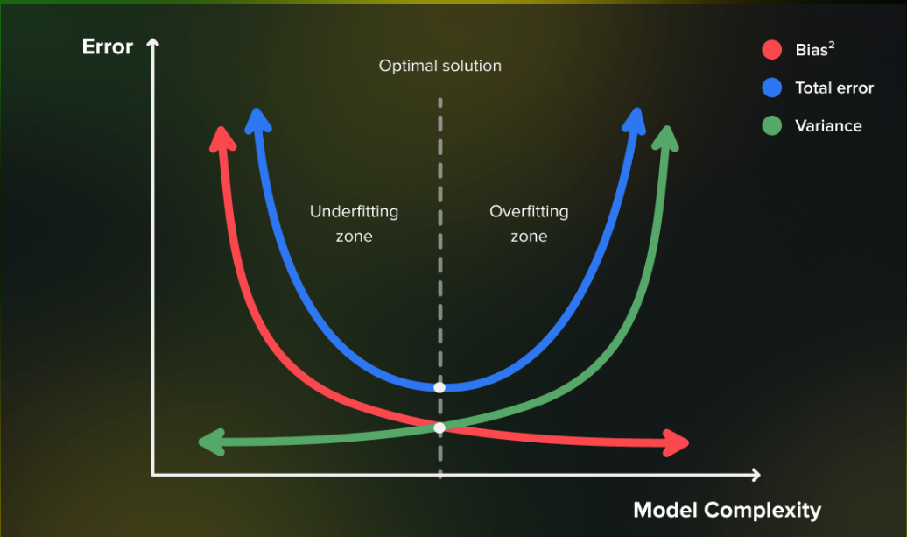
Bias-variance tradeoff
Bias and variance are interdependent. In other words, lowering a model’s bias leads to an increase in its variance and vice versa. This relationship between bias and variance is known as the bias-variance tradeoff.
Bias and variance serve as useful frameworks to understand the performance of machine learning algorithms in making predictions.

